Slide 1


Customer Churn Prediction
G.ROHITHA (192210242)
Malladi Priyanka(192111245)
DEPARTMENT OF COMPUTER SCIENCE AND TECHNOLOGY
PYTHON PROGRAMMING TO AUTOMATE TASKS CODE : CSAO874
FACULTY : Dr.A.Ganesh Ramachandran

Slide 2


Introduction to Customer Churn Prediction
Explore the hidden patterns in customer behavior that lead to churn. This presentation will unveil the power of data-driven insights using advanced machine learning techniques like logistic regression and decision trees.

Slide 3
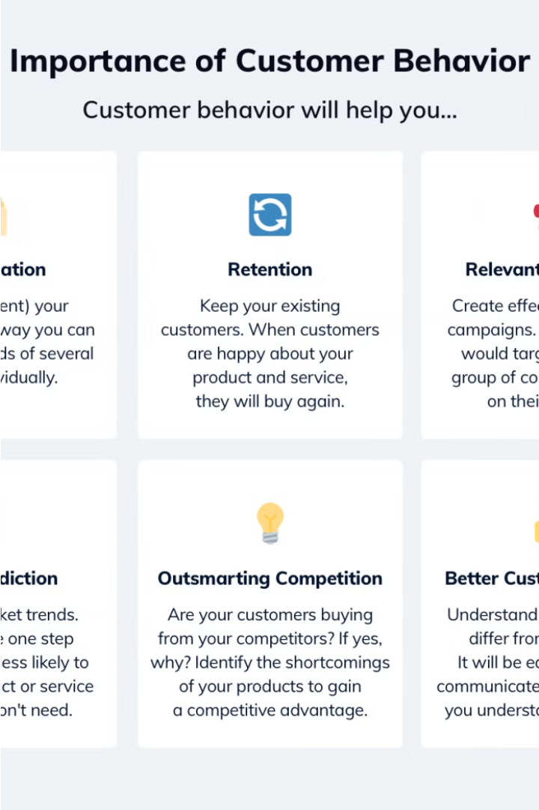
Importance of Understanding Customer Behavior
Analyzing customer behavior is crucial for businesses to identify patterns, predict churn, and optimize strategies. By understanding what factors influence customer decisions and loyalty, companies can develop targeted solutions to retain valuable clients and acquire new ones more effectively.
Examining customer interactions, purchasing habits, and feedback provides valuable insights that enable businesses to personalize their offerings, improve the customer experience, and reduce the likelihood of customers leaving.

Slide 4



Comparing Logistic Regression and Decision Tree Models
Model Complexity
Interpretability
Predictive Accuracy
Logistic regression is a simpler, linear model, while decision trees can capture more complex, non-linear relationships in the data.
Logistic regression provides more transparent, easily interpretable results, while decision trees can be harder to explain due to their hierarchical structure.
Decision trees often have higher predictive accuracy, especially on complex datasets, but can also be more prone to overfitting.

Slide 5





Data Preparation and Feature Engineering
Data Collection
1
Gather customer data from various sources
2
Data Cleaning
Handle missing values, outliers, and inconsistencies
3
Feature Selection
Identify the most relevant predictors of churn
4
Feature Engineering
Create new features to capture customer behavior
Data Transformation
5
Scale and normalize the features for optimal model performance
Effective data preparation and feature engineering are crucial steps in building accurate customer churn prediction models. This process involves collecting and cleaning the data, selecting the most relevant features, creating new predictive variables, and transforming the data to ensure the models can learn the underlying patterns in customer behavior.

Slide 6
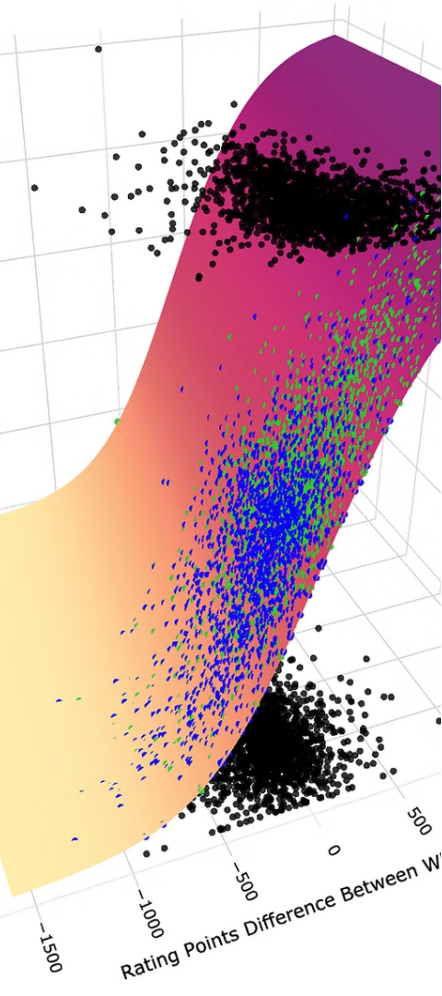



Logistic Regression Model Implementation
Data Preprocessing
Begin by cleaning and preprocessing the customer data, handling missing values, and encoding categorical features to prepare it for the logistic regression model.
Model Training
Fit the logistic regression model to the training data, optimizing hyperparameters to improve its performance in predicting customer churn.
Probability Thresholds
Explore different probability thresholds to balance the trade-off between false positives and false negatives, finding the optimal cutoff for churn prediction.

Slide 7
Decision Tree Model Implementation
Data Preparation
1
Clean and preprocess the data
Model Building
2
Construct the decision tree classifier
Hyperparameter Tuning
3
Optimize the model's parameters
To implement the decision tree model, we first need to ensure the data is properly prepared and formatted. We then construct the decision tree classifier, leveraging Python's scikit-learn library. Finally, we fine-tune the model's hyperparameters to optimize its performance on the customer churn prediction task.

Slide 8
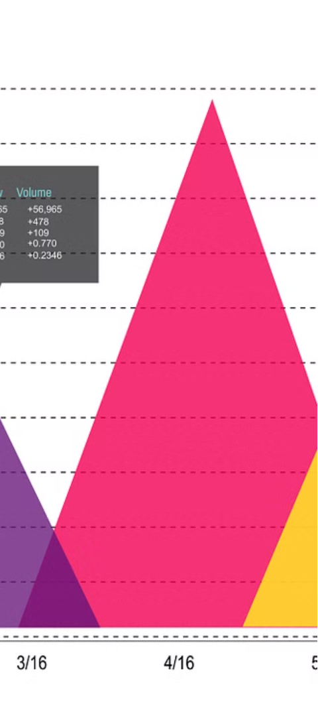
Model Evaluation and Comparison
1
Metrics Comparison
Evaluated and compared the performance metrics, such as accuracy, precision, recall, and F1-score, between the logistic regression and decision tree models.
2
Visual Analysis
Visualized the ROC curves and confusion matrices for both models to gain deeper insights into their strengths and weaknesses.
3
Model Interpretation
Interpreted the feature importance and coefficients of the logistic regression model, and the decision rules of the decision tree, to uncover patterns in customer behavior.

Slide 9
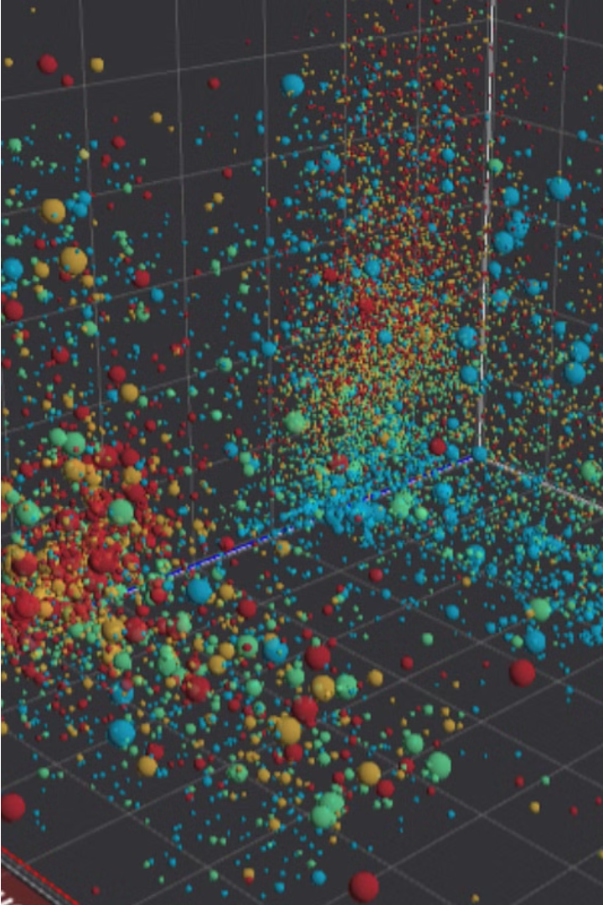
Identifying Patterns in Customer Behavior
By closely analyzing customer data, we can uncover valuable insights into their behavior and preferences. This allows us to identify key trends and patterns that drive customer churn, enabling more targeted and effective retention strategies.
Common patterns include changes in usage patterns, feedback and sentiment, demographic shifts, and changes in purchasing behavior over time. Leveraging these insights can help us proactively address potential churn risks.

Slide 10

Practical Applications of Churn Prediction
Targeted Marketing
Improved Customer Experience
Churn prediction helps identify high-risk customers, allowing businesses to proactively engage with them through personalized marketing campaigns to retain their business.
By understanding the factors that drive customer churn, companies can enhance their products, services, and overall customer experience to better meet the needs of their clients.
Optimized Resource Allocation
Churn prediction models enable businesses to allocate resources more efficiently, focusing retention efforts on the customers most likely to leave and maximizing the impact of their investment.

Slide 11
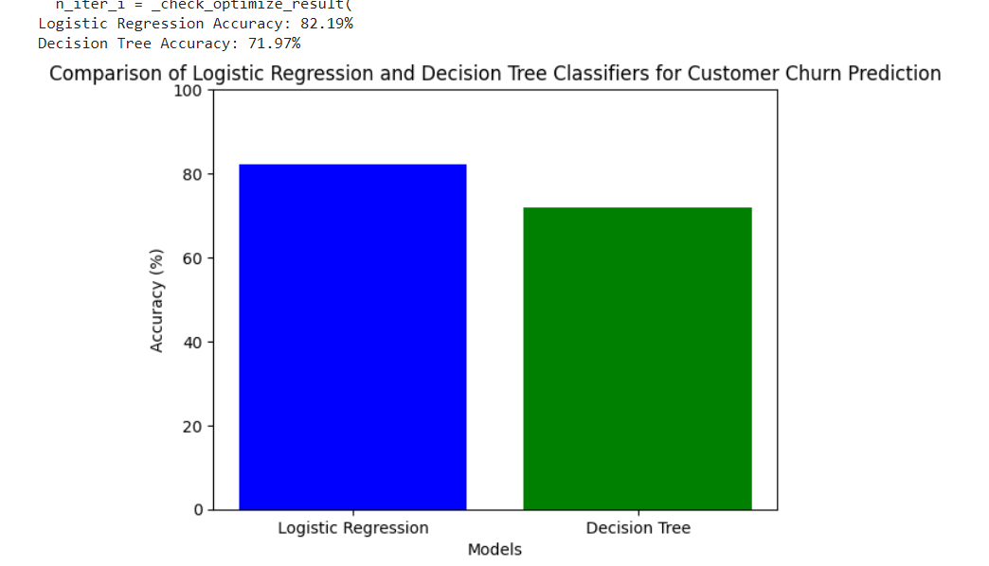
OUTPUT:
ALGORITHM | ACCURACY
Logistic Regression | 82.19%
Decision Tree | 71.9%

Slide 12

Conclusion and Future Considerations
In this presentation, we have explored the power of machine learning models in predicting customer churn. By comparing the performance of logistic regression and decision tree algorithms, we have uncovered invaluable insights into the patterns that underlie customer behavior. As we move forward, there are exciting possibilities for further refinement and application of these techniques.

Slide 13


